Slide 1
DFIR 102 – Investigation Methodology
Terryn Valikodath

Slide 2


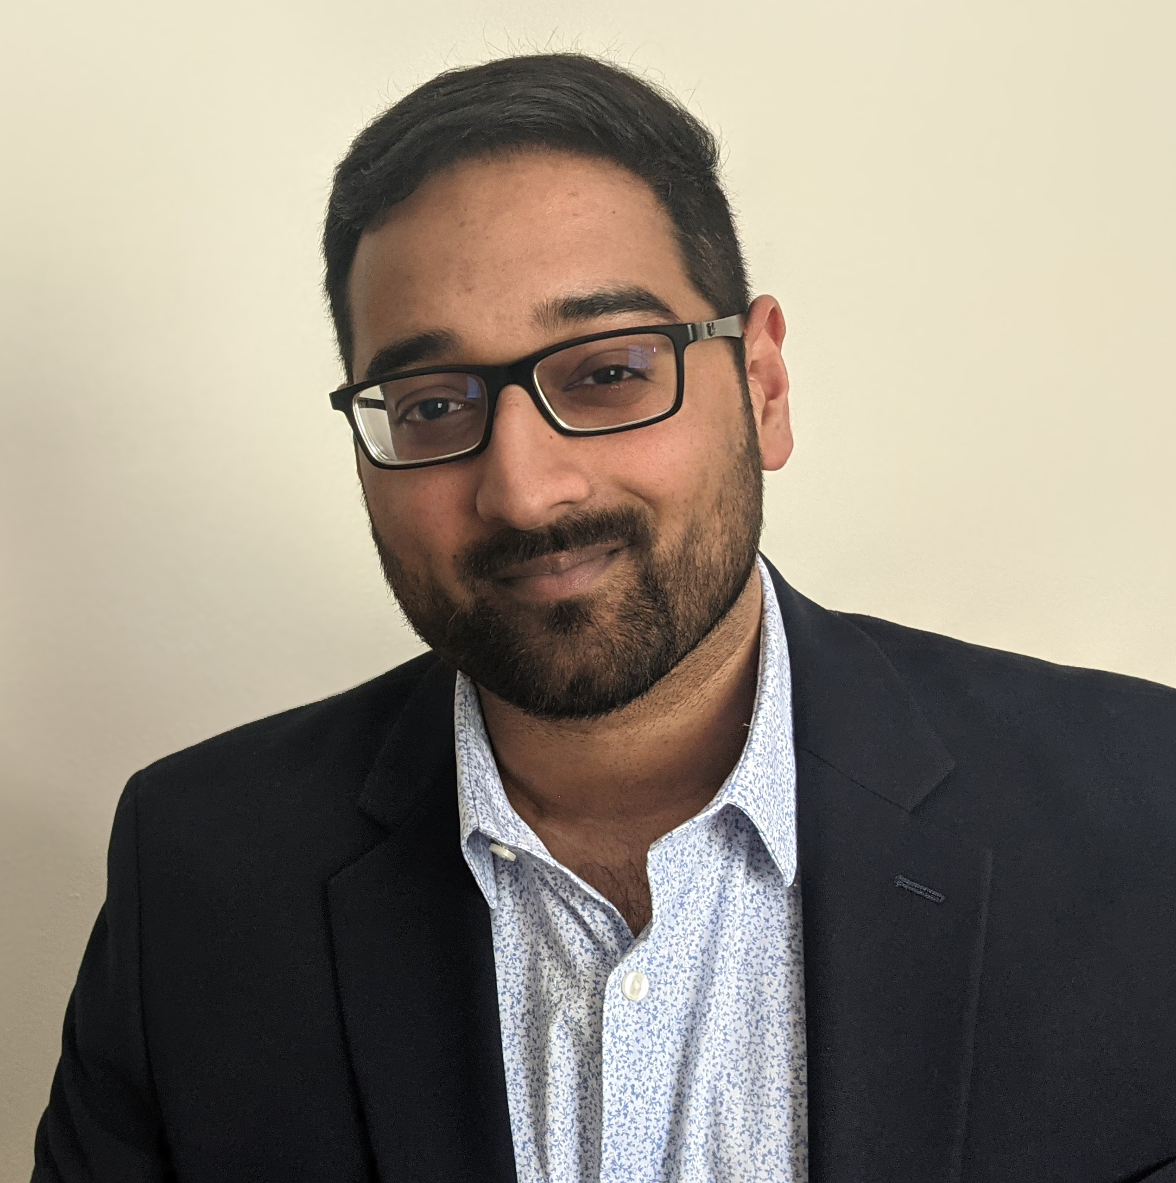
Terryn Valikodath
https://github.com/chocolatecoat
Background in the other forensics
Rooting and jailbreaking
Editing ROMS
Help Desk > General IT > Sysadmin > Application Support > Cybersecurity
DFIR Consultant
@CyberCoat

Slide 3
Who has had investigation training?

Slide 4
Background

Slide 5


What is a forensic investigation?
Observation
1” blue icon
Investigations are all about moving from the unknown, to the known, and then further to the provable.
Conclusion
1” grey icon
1” orange icon
Question
Forensic Investigation
1” yellow icon
1” yellow orange icon
Answer
Hypothesis

Slide 6
Investigator Mindset
1” blue icon
Create a hypothesis
1” orange icon
Understand what evidence you need to prove it
1” yellow orange icon
Determine if the evidence is attainable
1” yellow icon
Review and analyze the evidence
1” grey icon
Confirm if your hypothesis is correct, incorrect, or unable to be determined
Notes:
You already do this, but make it an active process
Expose and attack your cognitive biases
Form an educated guess about the answer to your questions
Consider your “because” statement
“I believe X because Y”
At times, you should consider if there is an adversary

Slide 7

Standards of a Successful Investigation
"Success should be based on the quality of the analysis, the completeness of the investigation, and if we were able to accomplish the objective, based on the technical and time constraints that were in play"
Notes:
All available digital evidence is competently handled (no changes are made and evidence can be validated)
All logical hypothesis are properly developed, investigated and proven or disproven
The incident is comprehensively, clearly and accurately reported
Although as forensic investigators, we always want to know all of the aspects of an incident, "root cause" is not always one of the established objectives for an ER engagement
Models and Frameworks are beneficial to having order and process, however there is no perfect model for every situation
Use your experience and intuition understand what works best and regularly review processes for necessary changes

Slide 8
MITRE ATT&CK Overview
Widely used industry framework
Free and open to everyone
Collection of adversary tactics, techniques and procedures (TTPs)
Tactics: the adversary’s technical goals
Techniques: How the adversary achieves their goals
Procedures: Implementation of techniques
Used for:
Cyber Threat Intelligence
Building a defense platform
Threat Hunting
Adversary Emulation, Red Teaming and Threat Modeling
Useful Links:
MITRE ATT&CK Website
https://attack.mitre.org/
ATT&CK Navigator
https://mitre-attack.github.io/attack-navigator/enterprise/
D3FEND
https://d3fend.mitre.org/
Notes:
Understanding the technology stack and technical controls deployed will assist CTIR to be able to identify applicable log sources, assist with scoping the incident, and assist in detection and correlation of malicious activity

Slide 9
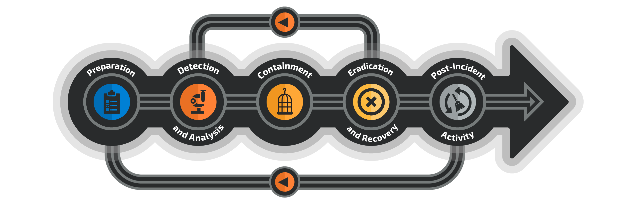
Incident Response Cycle

Slide 10
Investigative Process

Slide 11
Incident Scoping
One analyst should be dedicated to taking notes from the meeting/ticket/etc.
Incident Summary
Third Parties Involved
Objectives
Use templates for scoping notes, have prepared questions to ask
Psst… check my github
Goal:
Determine if the event should be considered an incident.
Understanding the incident and what needs to be done
Tools:
Scoping Notes Template

Slide 12
Incident Scoping (cont’d)
Have you seen this before?
Setup a briefing with IR team members:
Additional notes about the incident and organization
Evidence sources
Confirmed objectives
Next steps for each IR team member
Establish a communications cadence
Daily? Every few hours?
Goal:
Determine if the event should be considered an incident.
Understanding the incident and what needs to be done
Tools:
Scoping Notes Template

Slide 13
Evidence Collection
Collection of evidence through:
Forensic Image
Security Consoles
Log Files
Virtual System Files
Triage Scripts
Provision or obtain access to data sources such as consoles
Clear instructions on how to preserve and prepare
Preplan for analysis, expand the timeframe of investigation
Goal:
Preserve and prepare evidence for analysis

Slide 14

Triage vs. Full Disk
Using one does not mean you don’t need the other
Incident Response
Assess system to identify leads or suspicious activity
May impact live systems
Triage
Full Disk
Digital Forensics
Thoroughly investigate available data on a system
Should not impact live systems, but could require downtime
Notes:
This is not definite and there is not a clear answer on what is best, it depends on what the situation is.
Either way a memory dump should be sought after
Order of Volatility
Triage provides a way to rapidly assess a system to find additional leads or to better understand the activity on a system, especially where prior EDR visibility is lacking. This does not rule out collecting a full disk image, and this may very well be required to obtain specific files or indicators

Slide 15
Analysis
Organize and document evidence collected and associated data
Don’t rush into an investigation without a plan
Establish a clear task list
Objectives should give clear boundaries on what to investigate
Utilize indicators to identify TTPs associated with them
Goal:
Follow the established Investigation Strategy to meet determined objectives.
Write It Down:
What did you see?
Did anything standout?

Slide 16
Finding Evil
Malicious behavior may not always be identified before IR is engaged.
A baseline of expected activity will make it easier to identify suspicious behaviors
Common indicators:
Use the hypothesis approach to set end points. There will likely be several paths to follow. Note them down, but finish your current hypothesis
Rogue Connections
Unusual Processes
Unusual Services
Rogue Accounts
Unusual Files
AutoStart Locations

Slide 17
Findings
Findings should be identified with at least the following:
Timestamp
Event Description
Data Source
Including query or procedure
Context (Who, what, where, when, why)
Code (Filepath, registry entry, command)
Write out findings in “report format”, this eases the process of writing a report and allows you speak on findings during a conversation
TIP:
Understand the timestamp of your data source and always try to convert to UTC when possible
Develops consistent timeline
Notes:
Indicator of Compromise: a data point that indicates that a system or systems is or was under adversarial control
Indicator of Attack: a data point that indicates that a system or systems an adversary has attempted to compromise

Slide 18
Correlation
Take individual events and correlate them together
Correlate multiple evidence sources
Take time to extract indicators to assist with searching across the environment
Network (domain, IP)
File (SHA256, file path)
Account (name, group, privileges)
Analyze alongside the MITRE ATT&CK Framework to identify relevant TTPs
Goal:
What is the chain of events?
Write It Down:
Begin to record the indicators and timestamps in a central location.
Ensure that proper context is provided – why is this important?

Slide 19
Normalization & Deconfliction
Use standard time notation for events
ISO-8601 in UTC
2022-01-01T12:34:56Z
Use consistent terminology to identify similar fields from difference log sources.
Connected IP or Source Network Address = Source IP
Multiple instances of the same event may indicate a trend
5000 ICMP attempts to one host could indicate a DDOS attempt
Write It Down:
Group normalized indicators into clusters
Do not forget the context
Write it like your writing for someone who doesn’t know what your job is

Slide 20
Secondary Correlation
Second iteration of the first correlation, take a step back
Events have been normalized and similar events are combined
Provide statements that are representative of the adversary’s action by eliminating redundancies and ambiguities
Write It Down:
Write what happened in a report format
Be precise, be specific, and provide context.
Don’t leave room for assumptions

Slide 21
Timeline Analysis
Take your findings and input them into a table (CSV or Excel)
Allows for the creation of a sequence of events
Headers
Timestamp (UTC)
Host
Source
Event Type
Description
MITRE (optional)
Tools:
Log2timeline
Timeline Explorer
Excel
Goal:
When did key events take place?
Write It Down:
Standardized timestamps of important indicators but keep the output separate.

Slide 22
Intelligence Correlation
It is not intended to be exhaustive or comprehensive
MITRE ATT&CK provides a useful framework for documenting common Tactics, Techniques, Sub-Techniques, and Procedures often leveraged by adversaries.
The framework provides a construct to apply events that were identified and deconflicted in previous steps into a sequence of events.
What intelligence exists around the identified TTPs and indicators?
Goal:
Have we or someone else seen this before?
Write It Down:
What is associated together? Context.
What do the known TTPs tell us about the adversary capabilities, objectives, or detection opportunities?

Slide 23
Reporting
Don’t wait to start writing in a report format
Incident Reports have a variety of audiences each with their own specific needs
Headings
Incident Summary
Incident Timeline
Recommendations
Console Analysis Findings
Host Analysis Findings
Goal:
Explain what all this means
Write It Down:
You should have 90% of the report written in your notes
Ensure all team members have a chance to contribute and review
Notes:
CEO: What is the damage and how was it done?
CFO: How much is this going to cost me?
CISO: What can I do to keep that from happening again?
Network Architect: How did this happen and how can we prevent it in the future?
Security Engineer: What are the Tactics, Techniques and Procedures that were used and how do we prevent this in the future?
Intelligence Analysts: What are the indicators? Is this part of a campaign?

Slide 24
Final Steps
Setup time to debrief and follow up on recommendations
If you think something could improve, speak up and let your leadership know
Incidents are a great driver for necessary change
Take a breath and pat yourself on the back! Investigations are tough and can take a lot out of you
Step away every now and then to regroup
Know your limits
Ask for help

Slide 25
THANK YOU!
Questions?
Twitter
GitHub
@CyberCoat
Best way to contact me for questions about absolutely anything and ramblings
https://github.com/chocolatecoat/DFIR-Templates
Templates for Scoping, Forensic Notes, and Reports.
Always open to more ideas of what may be helpful.

